Slide 1
Event-Driven Stock Prediction using NLP
by Anant Jain, Ilya Yudkovich
CS 6120 Spring 2019 --- Prof. Lu Wang, Northeastern University

Slide 2
The price of a security reflects all of the information available, and that everyone has a certain degree of access to the information [Efficient Market Hypothesis (EMH)]

Slide 3
What the heck?
1
..what does it mean?

Slide 4
It implies..
Market is perfect.
Market is predictable and it repeats itself.
Peoples’ views matter (the key source of market volatility)
In this project, we present a news surveillance system targeting financial news to predict its impact on some of the top market cap companies.
Notes:
Today, a lot of new information related to companies and corporations listed on on the market appear constantly on the web, making an instant impact on the companies’ stock value. Surveilling all this information in real time is crucial but is not very much in reach of a lone investor.

Slide 5
Examples:
Ticker: AAPL.O
News: '''A U.S. federal judge has issued a preliminary ruling that Qualcomm Inc owes Apple Inc nearly $1 billion in patent royalty rebate payments, though the decision is unlikely to result in Qualcomm writing a check to Apple because of other developments in the dispute.'''
Prediction: “Buy”
Ticker: AMZN.O
News: '''PARIS Casino's upmarket Monoprix supermarket chain is working to expand its partnership with E-commerce giant Amazon in France, following a successful launch in Paris, Monoprix's Chief Executive said on Thursday.'''
Prediction: “Strong Buy”
Ticker: MSFT.O
News: SAN FRANCISCO Some Microsoft Corp employees on Friday demanded that the company cancel a $480 million hardware contract to supply the U.S. Army, with 94 workers signing a petition calling on the company to stop developing "any and all weapons technologies.'''
Prediction: “Sell”

Slide 6
What has been done before?
2
..and what we are doing?!

Slide 7
Related Work
[Xie et al., 2013]
Tree representations of information.
[Bar-Haim et al., 2011]
Identification of expert investors.
[Koganet et al. 2009]
Risk based on financial reports.
[Siet et al., 2013]
Sentiment analysis of news articles.
[Luss et al., 2012]
Word embeddings input and standard neural network prediction model.
[Ding et al., 2014]
Event embeddings input and convolutional neural network prediction model.

Slide 8
What are we doing? What’s new?
[Basics of NLP]
TF-IDF
N-Grams
Sentiment Analysis
[Traditional Deep NLP]
GloVe Embeddings
Bi-GRU & 1D CNN GM
Initialization & Training
[New Hotness]
Transformers
Fine-tuning
BERT

Slide 9
Methodology
3
..how are we doing stuff?!

Slide 10
37%
The top market-cap companies.

Slide 11


Dataset Construction
2,590,000 pages
2,590 tickers

Slide 12
Label Building Task
Historical Data
Calculated Relative Daily Return w.r.t. S&P 500
Cut by Quartiles:
Strong Sell
Sell
Buy
Strong Buy

Slide 13
Preprocessing
Pruning
Padding & Trimming
Extract top financial words which are abundantly used in financial articles.
Pad sequences to make the input consistent.
Vocabulary ~ 20,000
Maximum Sequence Length ~ 512 - 1000.
Model Selection
Feed the event tensors to deep learning models.
1D CNN GM, Bi-GRU, BERT.
Dimensions ~ 300
Event Embeddings
Use pre trained GloVe & BERT embeddings.

Slide 14
Model Selection and Evaluation
4
..what worked and what did not?!

Slide 15
38,386 total news events
30,637 training samples
7,749 validation samples
80%
20%

Slide 16
Evaluation Metrics
Accuracy: No problem as balanced classes!
Matthews Correlation Coefficient (MCC): measures quality of the classification irrespective of class balance

Slide 17
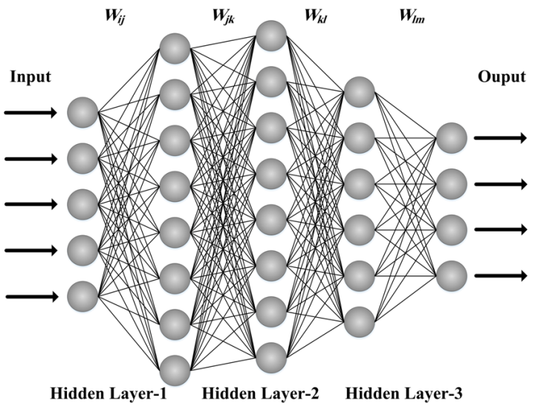
Model 1: Multilayer Perceptron
Activation: tanh
Nodes: 256, 128, 64, 32, 16
Solver: Adam
Measure | Value
Accuracy | 27%
MCC | 0.13965

Slide 18
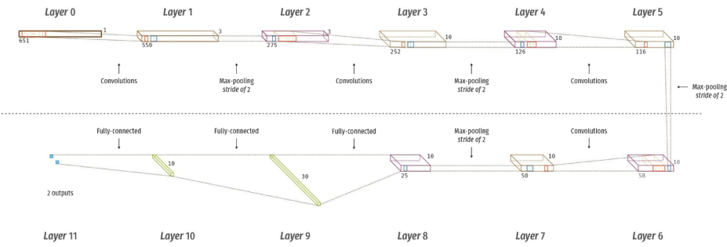
Model 2: 1D CNN with Global Maxpooling
Initialization,
Pre-trained knowledge is in embeddings
Everything else is 'from zero'
Need lots of training examples
Measure | Value
Accuracy | 64.43%
MCC | 0.2918

Slide 19
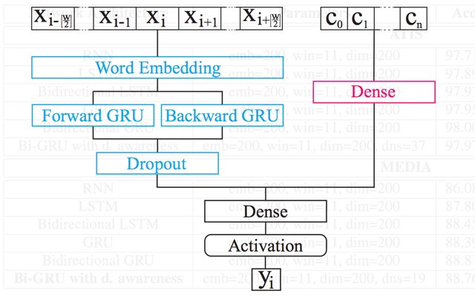
Model 3: Bidirectional-GRU
Initialization,
Pre-trained knowledge is in embeddings
Everything else is 'from zero'
Need lots of training examples
Measure | Value
Accuracy | 63.34%
MCC | 0.2111

Slide 20
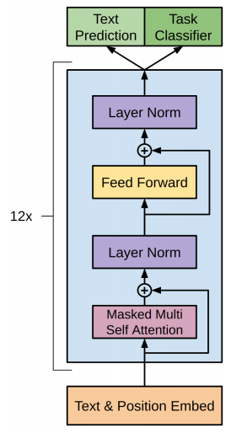
Model 4: Fine-tuning with BERT
Bidirectional Encoder Representations from Transformers
BERT:
Came out of Google (release 2018-10)
It’s full of transformers!
"BERT: Pre-training of Deep Bidirectional Transformers for Language Understanding" - Devlin et al (2018-10)
Fine Tuning
Take a model pre trained on huge corpus
Do additional training on your data
Learn actual task - using only a few examples
Measure | Value
Accuracy | 66.43%
MCC | 0.3010
Notes:
Bidirectional Encoder Representations from Transformers

Slide 21
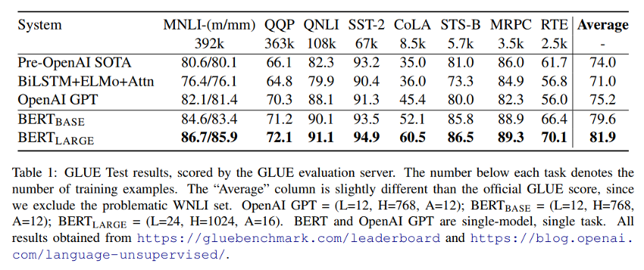
Bidirectional Encoder Representations from Transformers (BERT)
Notes:
Bidirectional Encoder Representations from Transformers

Slide 22
Comparing Results
Model | Accuracy | MCC
Luss and d’Aspremont [2012] | 56.42% | 0.0711
Ding et al.[2014] | 65.08% | 0.4357
1D-CNN GM (this project) | 64.43% | 0.2918
Bi-GRU (this project) | 63.34% | 0.2111
BERT (this project) | 66.43% | 0.3010

Slide 23
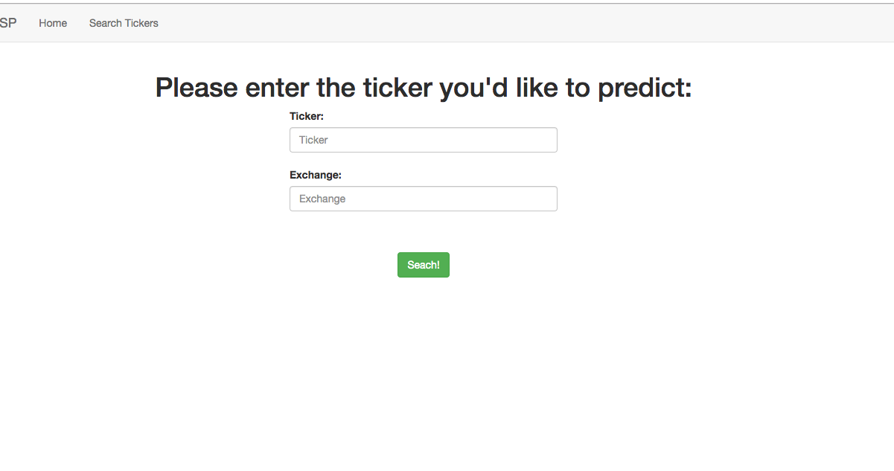
Place your screenshot here
LIVE PROJECT

Slide 24
Future work
Better label: comparing the stock price of the company to the corresponding industry, instead of comparing everything with S&P 500
Use data from other platforms (eg. Bloomberg)
Experiment more with BERT (give it more time)

Slide 25
THANKS!
Any questions?
Anant Jain
Ilya Yudkovich
Team #: 12

